Slide 1
Global Professional Services Industry MI
Corporate Research Desk
September, 2011

Slide 2





Table of Content
Global Professional Services MI
Market Overview
Industry Insights
Deals Space
Business Trends
Technology Trends
Competitive Landscape
Market Forecast
Disclaimer:
The information presented in this report is based on data available in the public domain. If you find that it is incorrect, please let us know.

Slide 3
Table of Content
Global Professional Services MI
Accountancy Market Overview
Market Overview
Legal Services Market Overview
Industry Insights
HR & Employment Services Market Overview
Deals Space
Management & Marketing Consultancy Market Overview
Business Trends
Real Estate Management & Development Market Overview
Technology Trends
Competitive Landscape
Market Forecast
Disclaimer:
The information presented in this report is based on data available in the public domain. If you find that it is incorrect, please let us know.

Slide 4
Global Professional Services Industry: Market Overview Accountancy Market Overview
Market Value
The accountancy market consists of revenues generated by firms engaged in designing, preparing and auditing accounting records. Income from tax, auditing, and advisory service provision is included.
For Japan, the market covers certified public accountant firms only.
The global accountancy market had total revenues of $ 364.3 billion in 2010, representing a CAGR of 3.6% between 2006 and 2010
Global accountancy market value: $ billion, 2006–10
The market is forecasted to accelerate, with an anticipated CAGR of 6% for 2010 - 2015, which is expected to drive the market to a value of $ 487.6 billion by the end of 2015
$ billion
% growth
Global accountancy market value: $ billion, 2006–10
Year | $ billion | % Growth
2006 | 316.2
2007 | 340.7 | 7.8%
2008 | 357.1 | 4.8%
2009 | 352.5 | -1.3%
2010 | 364.3 | 3.4%
CAGR: 2006–10 |  | 3.6%
Year
Notes:
Datamonitor Industry Profile - Global Accountancy (September 2011)

Slide 5
Global Professional Services Industry: Market Overview Accountancy Market Overview
Market Segment
Global accountancy market segmentation by service category:% share, by value, 2010
Category | 2010 ($ billion ) | %
Audit | 277.6 | 53.5%
Tax | 173.8 | 33.5%
Advisory | 61.2 | 11.8%
Global accountancy market segmentation by geography:% share, by value, 2010
Category | 2010 ($ billion ) | %
Americas | 177.0 | 48.6%
Europe | 121.7 | 33.4%
Asia- Pacific | 56.1 | 15.4%
Middle East & Africa | 9.5 | 2.6%
Notes:
Datamonitor Industry Profile - Global Accountancy (September 2011)

Slide 6
Global Professional Services Industry: Market Overview Legal Services Market Overview
Market Value
The legal services market includes practitioners of law operating in every sector of the legal spectrum. These include commercial, criminal, legal aid, insolvency, labor/industrial, family and taxation law
The market's value is calculated as the total revenues received by law companies for services rendered
The global legal services market had total revenues of $585.3 billion in 2010, representing a CAGR of 2.5% between 2006 and 2010
The number of legal professionals increased with a CAGR of 1.6% during 2006-10 , to reach a total of 3,285,250 in 2010.
Global legal services market value: $ billion, 2006–10
The market is forecasted to accelerate, with an anticipated CAGR of 5.1% for 2010 - 2015, which is expected to drive the market to a value of $751.7 billion by the end of 2015
$ billion
% growth
Global legal services market value: $ billion, 2006–10
Year | $ billion | % Growth
2006 | 530.0
2007 | 554.1 | 4.50%
2008 | 581.7 | 5.00%
2009 | 586.5 | 0.80%
2010 | 585.4 | -10.20%
CAGR: 2006–10 |  | 2.5%
Year
Notes:
Datamonitor Industry Profile - Global Legal Services (Dec 2011)

Slide 7
Global Professional Services Industry: Market Overview Legal Services Market Overview
Market Segment
Global legal services market segmentation: % share, by value, 2010
Americas accounts for 53.5% of the global market value
Europe accounts for a further 33.3% of the global industry.
Category | 2010 ($ billion ) | %
Americas | 313.2 | 53.5%
Europe | 196.1 | 33.5%
Asia- Pacific | 69.1 | 11.8%
Middle East & Africa | 8.2 | 1.4%
Notes:
Datamonitor Industry Profile - Global Legal Services (Dec 2011)

Slide 8
Global Professional Services Industry: Market Overview HR & Employment Services
Market Value
The human resources and employment services market consists of revenues received for provision of temporary staffing, search and placement (permanent staffing), and corporate training services provided by external service providers
The global accountancy market had total revenues of $377.1 billion in 2011, representing a CAGR of -3.4% between 2007 and 2011
Global accountancy market value: $ billion, 2006–10
The market is forecasted to accelerate, with an anticipated CAGR of 5.4% for 2011 - 2016, which is expected to drive the market to a value of $490.1 billion by the end of 2016
$ billion
% growth
Global legal services market value: $ billion, 2007–11
Year | $ billion | % Growth
2007 | 433.7
2008 | 428.1 | -1%
2009 | 325.4 | -24%
2010 | 356.4 | 10%
2011 | 377.1 | 6%
CAGR: 2007–11 |  | -3.4%
Year
Notes:
MarketLine Industry Profile - Global Human Resource & Employment Services (May 2012)

Slide 9
Global Professional Services Industry: Market Overview HR & Employment Services
Market Segment
Global HR & employment services market segmentation by service category:% share, by value, 2010
Category | 2011 ($ billion ) | %
Temporary Staffing | 271.16 | 71.9%
Corporate Training | 57.32 | 15.2%
Search and Placement | 48.65 | 12.9%
Global HR & employment services market segmentation by geography:% share, by value, 2010
Category | 2011 ($ billion ) | %
Europe | 144.8 | 38.40%
Americas | 128.6 | 34.10%
Asia- Pacific | 75.1 | 19.90%
RoW | 28.7 | 7.60%
Notes:
MarketLine Industry Profile - Global Human Resource & Employment Services (May 2012)

Slide 10
Global Professional Services Industry: Market Overview Management & Marketing Consultancy Market
Market Value
The Management & Marketing Consultancy Market consists of total revenues received for the provision of corporate strategy services, operations management services, information technology solutions, human resource management services and outsourcing services
The global Management & Marketing Consultancy market had total revenues of $301.1 billion in 2011, representing a CAGR of 3.6% between 2007 and 2011
Global Management & Marketing Consultancy market value: $ billion, 2007-11
The market is forecasted to accelerate, with an anticipated CAGR of 6% for 2011 - 2016, which is expected to drive the market to a value of $402.3 billion by the end of 2016
$ billion
% growth
Global Management & Marketing Consultancy market value: $ billion, 2007-11
Year | $ billion | % Growth
2007 | 261.5
2008 | 280.8 | 7.4%
2009 | 268.9 | -4.2%
2010 | 283.6 | 5.5%
2011 | 301.1 | 6.2%
CAGR: 2007–11 |  | 3.6%
Year
Notes:
MarketLine Industry Profile - Global Management & Marketing Consultancy (Aug 2012)

Slide 11
Global Professional Services Industry: Market Overview Management & Marketing Consultancy Market
Market Segment
Global management & marketing consultancy market segmentation by service category:% share, by value, 2010
Category | 2011 ($ billion ) | %
Operations management | 91.23 | 30.3%
Information technology | 65.04 | 21.6%
Corporate strategy | 56.00 | 18.6%
Human resources management | 36.43 | 12.1%
Other | 52.09 | 17.3%
Global management & marketing consultancy market segmentation by geography:% share, by value, 2010
Category | 2011 ($ billion ) | %
Europe | 151.2 | 50.2%
Americas | 115.0 | 38.2%
Asia- Pacific | 33.4 | 11.1%
RoW | 1.5 | 0.5%
Notes:
MarketLine Industry Profile - Global Management & Marketing Consultancy (Aug 2012)

Slide 12
Global Professional Services Industry: Market Overview Real Estate Management & Development Market
Market Value
The real estate management and development industry consists of companies engaged in real estate ownership, management and/or development.
The industry is valued using the total revenues generated by these companies via leasing and property management activities
Global real estate management and development market value: $ billion, 2006–10
The market had total revenues of $479.3 billion in 2011, representing a CAGR of -0.5% between 2007 and 2011
The market is forecasted to decelerate, with an anticipated CAGR of -0.1% for 2011 - 2016, which is expected to drive the market to a value of $477 billion by the end of 2016
Global real estate management and development market value: $ billion, 2007–11
$ billion
% growth
Year | $ billion | % Growth
2007 | 488.5
2008 | 501.6 | 2.7%
2009 | 461.4 | -8.0%
2010 | 460.4 | -0.2%
2011 | 479.3 | 4.1%
CAGR: 2007–11 |  | -0.5%
Year
Notes:
MarketLine Industry Profile - Global Real Estate Management & Development (Aug 2012)

Slide 13
Global Professional Services Industry: Market Overview Real Estate Management & Development Market
Market Segment
Global real estate management and development market segmentation by service category:% share, by value, 2010
Category | 2011 ($ billion ) | %
Residential | 272.24 | 56.8%
Non-Residential | 207.06 | 43.2%
Global real estate management and development market segmentation by geography:% share, by value, 2010
Category | 2011 ($ billion ) | %
Americas | 193.6 | 40.4%
Europe | 161.0 | 33.6%
Asia- Pacific | 110.2 | 23.0%
Middle East & Africa | 13.9 | 2.9%
Notes:
MarketLine Industry Profile - Global Real Estate Management & Development (Aug 2012)

Slide 14
Table of Content
Global Professional Services MI
Market Overview
Value Chain Analysis for the Industry Segments
Industry Insights
Growth Drivers & Challenges to IT Outsourcing for the Industry Segments
Deals Space
Porter's 5 forces Analysis
Business Trends
Technology Trends
Competitive Landscape
Market Forecast
Disclaimer:
The information presented in this report is based on data available in the public domain. If you find that it is incorrect, please let us know.

Slide 15
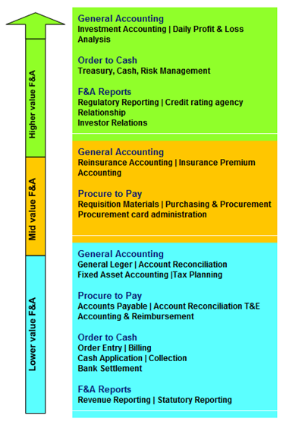
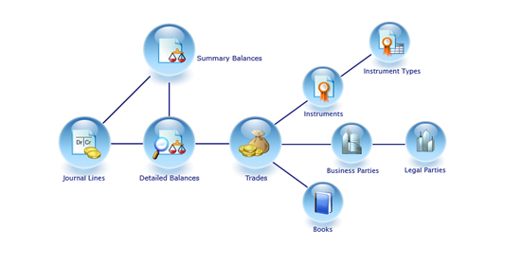
Global Professional Services Industry: Industry Insights
Value Chain Analysis - Accounting Services
ACCOUNTING INDUSTRY VALUE CHAIN
Finance and Accounting (F&A) outsource Value Chain
Record
Business
Events
Summarize
events into
external
reports
Summarize
events into
internal
reports
Transform
data into
information
&
knowledge
Value
added
decision
making
SUPPORT ACTIVITIES
R&D
Design
Production
Marketing
Distribution
Customer
Service
Accounting Process
- 15 -
Notes:
Sources:
http://www.cybelink.com/finance-and-accounting-fa-outsource-value-chain/
http://www.microgen.com/uk-en/index.php?page=microgen-accounting-hub-2

Slide 16
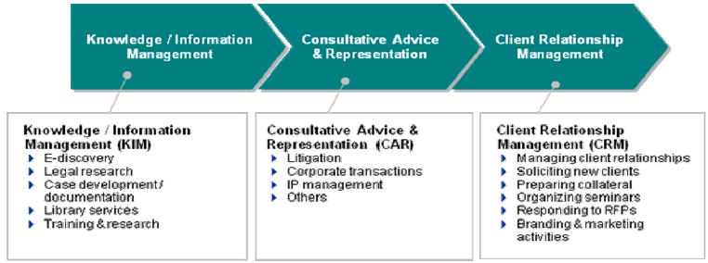
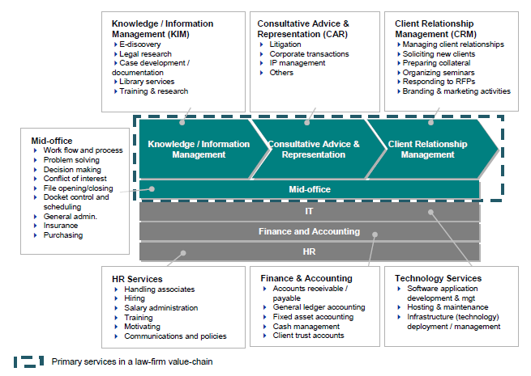
Global Professional Services Industry: Industry Insights
Value Chain Analysis - Legal Services
Disintegration of Legal Services
Value Chain of a Law Firm
- 16 -
Notes:
Source:
http://www.sbs.ox.ac.uk/centres/professionalservices/Documents/SAKO%20Global%20Strategies%20by%20LPO%20paper%20June2010.pdf

Slide 17
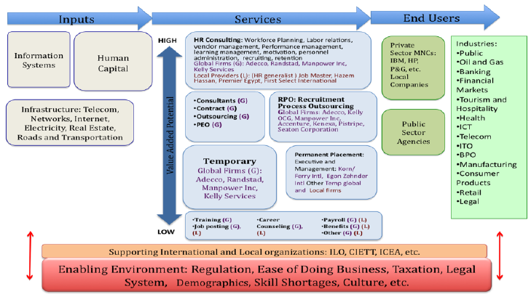
Global Professional Services Industry: Industry Insights
Value Chain Analysis - HR & Employment Services
Employment & HR Industry Value Chain has three primary components: Industry Inputs, Services provided & End Users.
Moving from left to right, core activities of the industry include recruitment, selection and placement of human capital.
Industry is driven by customer demand, is highly relational and is impacted by the regulatory environment.
Primary inputs are human capital; information technology and local infrastructure and the end users are employers in the public and private sectors.
Most important is the industry's enabling environment and supporting institutions, which constitute the fourth and fifth components of value chain and have significant impact on each stage in the chain, type and level of service, and degree of market penetration.
- 17 -
Notes:
Source:
http://www.cggc.duke.edu/pdfs/Ahmed_MP_EmploymentHRServices.pdf
http://www.citehr.com/28758-hr-value-chain.html

Slide 18
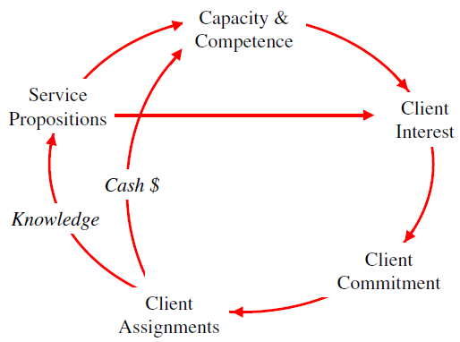
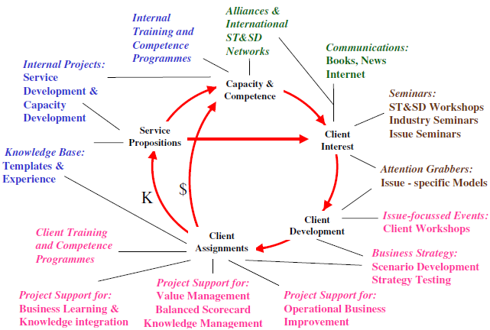
Global Professional Services Industry: Industry Insights
Value Chain Analysis - Management Consultancy Services
Business Consulting Value Cycle
Value Chain Dynamics for Business Consulting Value Cycle
- 18 -
Notes:
Source:
http://www.systemdynamics.org/conferences/1999/PAPERS/PLEN13.PDF

Slide 19
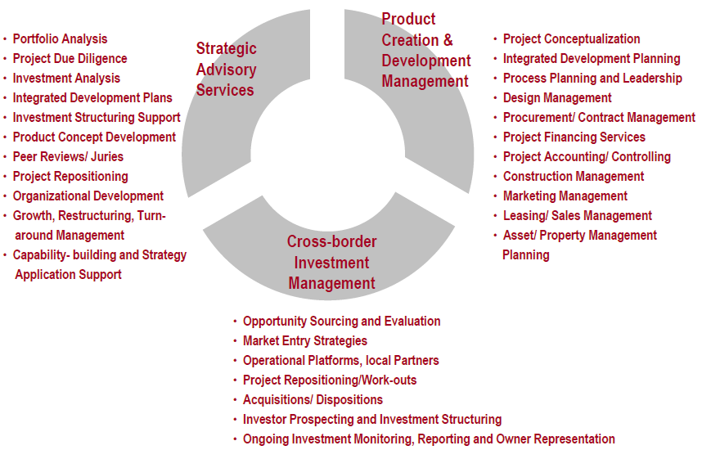
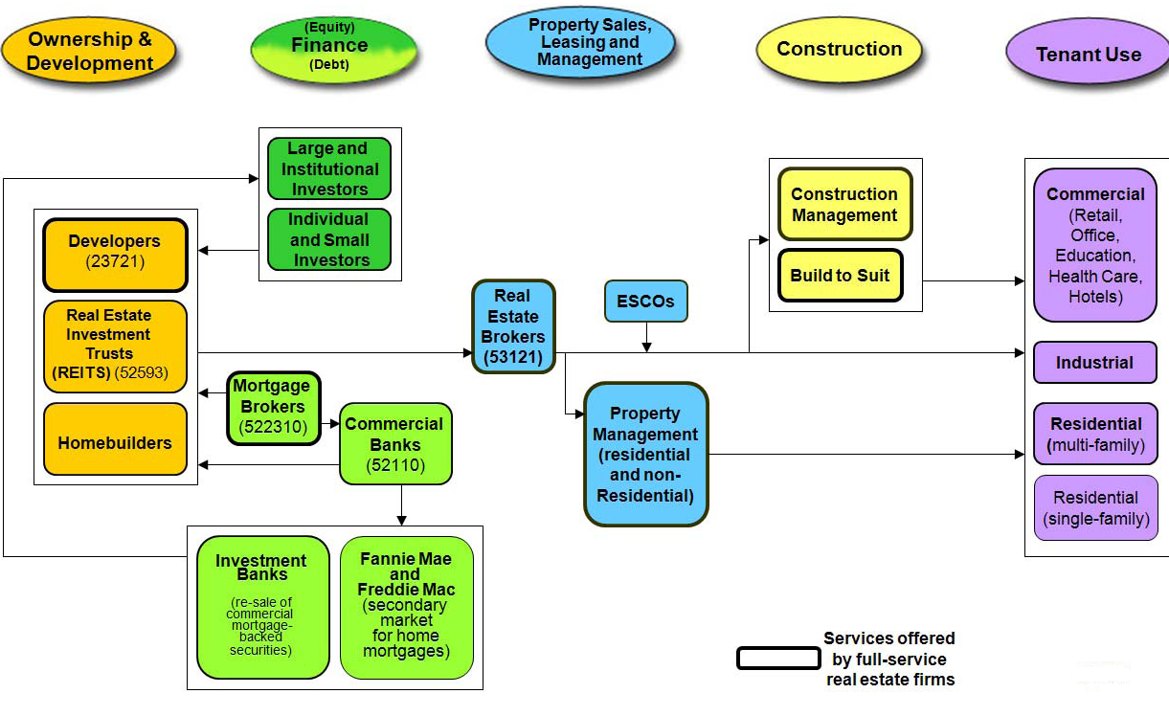
Global Professional Services Industry: Industry Insights
Value Chain Analysis - Real Estate Advisory Services
Real Estate Consulting Services
Real Estate Industry Value Chain
- 19 -
Notes:
Sources:
http://www.mananpartners.com/mananpartners.pdf
http://www.cggc.duke.edu/environment/valuechainanalysis/CGGC_RealEstateReport_4-22-08.pdf

Slide 20
Global Professional Services MI: Industry Insights Growth Drivers & Challenges to IT Outsourcing - Accountancy Services
Growth Drivers
Hosted Software: Hosted (SaaS) bookkeeping software reduces IT costs, the need for expensive computer upgrades, or the need for businesses to handle daily back-ups or worry about security in regard to their bookkeeping software.
Growth Challenges
Cutbacks in top accounting firms can imply less willingness to outsource IT applications due to lack of scale.
Cloud Accounting: The idea of cloud accounting is way to add value and capacity to organizations without investing in personnel training and setting up new systems and software. It comprises of either broad based subscription or pay-per use service that, adds value to the incumbent IT capabilities by providing real time over the web.
Advent of Virtual Accountants and Social media has made IT a critical part of accountancy services industry.
Most of the accountancy services firms do not want to invest in in-house IT and focus on their core competencies.
Use of eLearning technology in our learning delivery process
Profitability of individual firms depends on the right mix of services and effective marketing.
Large firms have advantages in providing wider ranges of services to large corporate clients and having the resources to serve customers with many locations.
Small firms can compete effectively by specializing and providing superior service.
The industry is labor-intensive: average annual revenue per worker is about $130,000.
- 20 -
Notes:
Sources:
http://www.accountingdepartment.com/blog/improving-sales/accounting-services-industry-trends-virtual-accounting-personalized-service/
http://ezinearticles.com/?Cloud-Accounting?-Gaffe-or-Your-ABC-to-Accounting-Solutions&id=6027150
http://www.firstresearch.com/Industry-Research/Accounting-Services.html

Slide 21
Global Professional Services MI: Industry Insights Growth Drivers & Challenges to IT Outsourcing - Legal Services
Growth Drivers
Many North American legal firms are buckling under pressure of e-discovery requirements, and relying on IT staff to carry out e-discovery on digital records.
Growth Inhibitors
Outsourcing high technology patent work has the potential for severe criminal and civil penalties and the responsibility falls upon the exporter to determine if an export license is required.
In 2009, out of $7 billion total IT outsourcing revenues, some $5 billion could be credited to work brought in by call centers. So-called KPOs like legal and medical transcription and processing was a close second with more than $1.18 billion in revenues for the same period.
Electronic discovery legislation in Canada and the U.S. is largely fueling the demand for outsourced legal work
Legal Services firms look for easy exit clauses in contracts with their outsourcing partners, enabling them to exit the arrangement as easily as possible, if required.
- 21 -
Notes:
Sources:
http://www.globalservicesmedia.com/BPO/Knowledge-process-Outsourcing/North-American-Law-Firms-Outsourcing-Legal-Research/23/12/9349/GS100217198082
http://legalprocessoutsourcing1.wordpress.com/2011/06/05/the-challenges-of-legal-process-outsourcing-lpo/

Slide 22
Global Professional Services MI: Industry Insights Growth Drivers & Challenges to IT Outsourcing- Staffing Industry
Growth Drivers
Cloud Computing: →Cloud Computing is expected to transform a staffing firm’s IT spending from capital expenditure to operating expense, from up-front lump sums to monthly pay-per-user. →Staffing software solutions, such as eEmpACT On Demand, provide a single database for integrated front- and back-office operations utilizing the latest in Cloud Computing to streamline your workforce, regardless of size and financial level. →Cloud Computing is being hailed as the future of the mobile staffing office.
Growth Challenges
Customer Retention, Supply Shortage & Applicant loyalty, High operation costs, while seeking innovative options and models to reduce their back office costs and improve their profitability.
These challenges call for a completely managed solution combining BPO services with internet based architecture and applications that would enable staffing companies to outsource the two-mission critical functions of their industry – billing customers and paying candidates/suppliers.
Staffing firms are increasingly looking to reduce back office costs, streamline business process through automation, front to back office integrations and integration with VMS systems.
- 22 -
Notes:
Sources:
http://www.eminfo.com/article.asp?aid=116
http://www.infosysblogs.com/oracle/2010/03/managed_solution_for_staffing.html

Slide 23
Global Professional Services MI: Industry Insights Growth Drivers & Challenges to IT Outsourcing - Real Estate & Consulting
Growth Drivers
Move to cloud can help real estate companies reduce costs, free up space and create flexible working environment.
Growth Challenges
Global economic crisis has led to more stringent credit market requirements and regulations, making the raising of necessary capital more difficult.
Recent recession has led to increased tenant bankruptcies, which in turn have led to an increase in vacancy rates and losses in companies' revenues.
APAC region is expected to see interesting developments in the commercial sector during next five years driven by strong economic growth.
Opportunities in the US may lie within the retail sector in real estate market.
- 23 -
Notes:
Sources:
http://www.cloudtweaks.com/2011/03/real-estate-and-cloud-computing/
http://pro.truliablog.com/tools-trends/demystifying-the-cloud-cloud-computing-for-real-estate/
Datamonitor Report: Global Real Estate Management & Development, June 2011

Slide 24
Global Professional Services MI: Industry Insights Porter's 5 forces Analysis- Accountancy Services
Rivalry- Strong
• Despite the dominant position of the "big four" firms, the global accountancy market is fairly fragmented overall, which increases rivalry- players are very similar to each other
• Although accountancy firms have few specialized physical assets to dispose of, their staff will tend to have specialized skills.
• Exiting the accountancy market would therefore incur costs: IT systems could be re-deployed in another business area, but laying off a large staff and recruiting a new one with different skills is not a trivial exercise
Supplier Power- Moderate
• Suppliers in the accountancy market consist of specialized accountancy software publishers
• Large accountancy firms need more specialized technology, and therefore rely on a limited range of suppliers to provide this
• the wide range of low end and high end products on offer, such as ERP software- weakens supplier power
• Other suppliers to accountancy firms will include manufacturers of PCs and office equipment.
•Accountancy firms require a reliable ICT infrastructure to be in place and therefore often commit to one supplier's product
New Entrants- Strong
• Entry to the global accountancy market may be achieved by an individual accountant establishing a single practice. For such a low-key entry, there is relatively little capital outlay or proprietary knowledge involved
• The global market has grown at a healthy rate in recent years, making it attractive to new entrants
• The leading companies have strong brand reputations
• Competing for the largest clients is difficult except for the major accountancy firms
• Replication of competencies can be costly, and constitutes a barrier to market entry
Buyer Power- Moderate
• Buyers can vary in size but include many medium and large businesses, which strengthens buyer power considerably
• Four major players dominate the accountancy market: PWC, KPMG, Deloitte Touche Tohmatsu, and Ernst & Young- limited choice of player for the largest corporate clients
• Switching from a "big four" auditor to a smaller player may be viewed negatively by the capital markets
• Buyer power is strengthened by the fact that accountants as such can rarely integrate forwards into their clients' businesses, while clients can carry out some accounting functions inhouse
Threat of Substitutes - Weak
• While there are no obvious substitutes for the functions offered by accountants, specialized accountancy firms do face the threat of substitutes
• For private individuals, "DIY" accounting is often a possibility
• This substitute avoids costs in terms of fees paid to a third-party accountant, but may incur other costs, such as the time absorbed by the process, and the greater possibility of mistakes being made
There may also be switching costs, such as the need to purchase appropriate software
• Also, the important function of auditing cannot by its nature be performed in-house
- 24 -
Notes:
Sources:

Slide 25
Global Professional Services MI: Industry Insights Porter's 5 forces Analysis- Legal Services
Rivalry- Strong
• Legal firms can diversify their practice in terms of the range of areas they are involved in, from antitrust and competition to banking and finance, which tends to ease rivalry
• For the biggest firms that cover the breadth of the market, there is huge rivalry for reputation and the big deals
• Since liberalization, basic legal tasks can be completed at reduced costs in many countries
Supplier Power- Moderate
• Suppliers in this market include manufacturers of ICT equipment and office supplies
• As market players often stick to one ICT supplier in order to keep consistency throughout the business and avoid the difficulties of training staff on new computer systems, supplier power is increased
• The biggest cost, and subsequently asset, for a law firm is its staff, which needs to be of a high quality to maintain a competitive edge over rivals
•The success of the practice as a whole depends on attracting and retaining suitably qualified legal professionals, with expertise in the specific areas of law in which the partnership operate- Should one partner leave, it may be difficult to find a replacement with equivalent skills
New Entrants- Strong
• The global legal services market is continuing to expand, providing ample opportunities for new players wanting to enter
• Leading incumbents have some advantages, which may make it harder for new entrants to compete
• A larger firm may have economies of scale, being able to offer a broader range of expertise to clients
• It may be difficult for clients to assess the relative skills of competing firms in this market, and a high reputation ('brand strength') is an advantage for certain incumbents that new entrants cannot immediately offer
• There may be restrictions on foreign lawyers practicing within a particular country, although WTO rules generally favor greater international trade in services, including legal services
Buyer Power- Moderate
• Wide variety of potential customers in the market- weakens buyer power
• Larger clients tend to have stronger bargaining power
• Switching tends to be fairly low-cost in this market
• The services offered by legal practitioners are generally highly important to buyers. However, larger companies may backwards integrate by introducing in-house legal services, thus putting legal firms under pressure
• Brand can play an important role in the legal services market, with reputation often being an important factor when choosing a legal services company
• Services offered by law firms tend to be very similar, however companies may differentiate themselves by specializing in one area
Threat of Substitutes - Moderate
• While there are no obvious substitutes to legal services as such, some individuals may choose to represent themselves
• However, legal issues can be complex, the consequences of errors can be significant, and for businesses undertaking a wide range of activities, including mergers and acquisitions, professional legal expertise is a must
• However, the biggest threat to third-party legal firms is the use of in-house lawyers
• Large companies may operate in-house departments that handle the majority of the corporation's legal needs. The advantages of this for buyers may include reduced costs if the service is commonly required, and a more tailored service as the lawyers are focused on only one company
- 25 -
Notes:
Sources:

Slide 26
Global Professional Services MI: Industry Insights Porter's 5 forces Analysis- HR & Employment Services
Rivalry- Strong
• The global market consists of a large number of highly reputable companies with strong brand names, which boosts the competition level
• The growth of internet services has reduced barriers to entry and has triggered a growth in the number of players in this market
•The larger players present similar business models and usually conduct diversified operations
• Demand for services is dependent upon a number of global trends, such as demand for skilled workers, as well as economic growth
Supplier Power- Moderate
• Market players invest large sums of money in ICT systems, for which they typically have contracts with large technology providers and therefore incur raised switching costs
• likely to remain with one ICT supplier in order to maintain consistency throughout the business
• Changing suppliers can incur significant costs in terms of staff training, or the impact of a new system not being compatible with an existing one
• With high unemployment rates as a result of the global economic downturn, the abundance of prospective employees weakens supplier power
New Entrants- Moderate
• Large companies in this market benefit from significant scale economies in terms of marketing and back-office operations
• small companies can compete successfully by specializing
• However, some country markets are becoming more heavily regulated in terms of improvements in legislation to protect temporary workers from exploitative employment practices
• Strong market growth may attract new entrants. Uncertainty in the global economy tends to direct buyers towards staff reductions in order to lower their costs; thus new entrants may be discouraged from entering the market
Buyer Power- Strong
• Wide variety of potential customers in the market with large and medium sized businesses, with financial muscle allowing them to make large purchases
• Number of buyers is limited by difficult global economic conditions and the automation of business processes due to advances in ICT
• Switching costs are not significant
• More buyers are moving towards consolidating their purchases by using a single market player or a small group of them
• Many buyers backward integrate, conducting their own human resources and employment services thereby reducing their dependence on market players
Threat of Substitutes - Strong
• Buyers conducting their own recruitment and human resources, rather than out-sourcing to market players
• The use of market players can be beneficial; for example, in terms of sourcing the most suitable employees and saving time
• Another form of substitution exists in terms of web-based operations; however, most of the players have already incorporated this method of operating into their business models
- 26 -
Notes:
Sources:

Slide 27
Global Professional Services MI: Industry Insights Porter's 5 forces Analysis- Management & Marketing Consultancy
Rivalry- Moderate
• The leading firms in this market are typically large corporations, intensifying the rivalry as they can harness greater power for competitive practices
• High service differentiation and low exit barriers ameliorate the rivalry as firms compete in different areas and will not stay and compete due to the sunk costs involved if exit was necessary
•The persisting global slowdown has forced many firms which would use consulting services to consolidate and delay new investment projects
• The steady growth in the market means expanding revenue streams will mollify the rivalry
Supplier Power- Strong
• Suppliers- producers of ICT hardware and software, typically large multinational firms
• Firms are also beginning to capitalize on social media, with project managers attempting to integrate it into ERP systems
• Emerging services involve binding companies with long term contracts, which would incur high switching costs, not only to exit the contract, but also to conduct the restructuring of the systems and subsequent training necessary
• Although some providers have their own consultancy division, such as IBM’s Global Services, forward integration by suppliers is unlikely
New Entrants- Moderate
• The leading firms are multinational companies with strong brand images
• Smaller firms with specialist services successfully compete in the market
• The large companies benefit from economies of scale, combined with a vast knowledge pool spanning many industries and sectors
• Track record of improving cost-efficiency is a distinct advantage, which presents a significant barrier for new, unproven companies
• Firm involves a high degree of specialist and proprietary knowledge, with established companies developing a high degree of in house expertise, disadvantaging new entrants
• Moderate growth observed by the market in recent years will act as an incentive for new companies to enter
Buyer Power- Strong
• The public sector is a big customer for the services in order to improve efficiency and reduce long term costs
• This demand looks uncertain in the short term as many governments implement austerity programs
• The service is relatively costly due to the high level of specialized knowledge required and can act as a deterrent for smaller companies
• Consulting is quite a dispensable product for firms' operations, but will still prove necessary in some cases, such as when the existing management structure proves inadequate to accommodate a large change process
• The market permits large differentiation and customization of the services offered, which dilutes buyer power
Threat of Substitutes - Strong
• Many larger companies and organizations have created in-house business departments which employ analysts and marketing teams for business insights and to achieve organizational efficiencies
• However, running such a department can be very costly and only well established companies with the constant need for these services may possess the resources to do so.
• Only mature consultancy firms could be a match for in-house departments when it comes to the knowledge of a specific area of a market that an individual company's operations will have accumulated over many years
- 27 -
Notes:
Sources:

Slide 28
Global Professional Services MI: Industry Insights Porter's 5 forces Analysis- Real Estate Management & Development
Rivalry- Moderate
• The industry is highly fragmented with small companies competing alongside large multinational players
• Typical player generates little revenue in other markets, meaning that the real estate industry is highly important to revenues
•Globally, growth rates in recent years have been unexciting; and a decline in value has been seen in recent years
• Player who are able to diversify geographically may find some regions more profitable than others
• The recent economic downturn has led to increased tenant bankruptcies, which in turn have led to an increase in vacancy rates and losses in companies' revenues
Supplier Power- Moderate
• Suppliers- building and construction contractors
• The large number of such companies serves to weaken supplier power considerably
• Supplier offerings are mostly undifferentiated service.
• Certain contracts are long term which associates switching cost
• The services offered by suppliers are of importance to market players, strengthening supplier power further
• The ability of market players to attract and retain employees is generally vital to the success of a business
New Entrants- Moderate
• Financial pressure can arise for new companies, as significant investment is required and there is usually a period of time before revenues
• Global economic crisis has led to more stringent credit market requirements and regulations, making the raising of necessary capital more difficult
• The markets in which players operate can often be uncertain
• Such uncertainty can be off-putting for potential new entrants
• Forecast market stagnation over the coming years will do little to entice new entrants to the market
Buyer Power- Moderate
• Buyers within this industry are of widely disparate size and financial strength, so the effect of their large number, usually weakening buyer power, may be mitigated by their strong financial muscle and ability to negotiate with players
• Name recognition can play a role in attracting buyers in this industry
• However price, location, suitability, and related factors, are likely to be more important
• Market players can differentiate themselves through the types of property they offer, location and services offered, such as brokerage
Threat of Substitutes - Weak
• From the point of view of customers, the main alternative to real estate management is to buy property, rather than lease it
• Property may be bought using a variable-interest loan: both interest rates and rents can be unpredictable in the medium- to long term
• Property owners will have responsibilities for maintenance etc, which management and development companies would often include as part of their service
- 28 -
Notes:
Sources:

Slide 29
Table of Content
Global Professional Services MI
Market Overview
HR & Employment Services Deals
Industry Insights
Legal Services Deals
Deals Space
Management & Marketing Consultancy Deals
Business Trends
Real Estate Services Deals
Technology Trends
Competitive Landscape
Market Forecast
Disclaimer:
The information presented in this report is based on data available in the public domain. If you find that it is incorrect, please let us know.

Slide 30
Global Professional Services Industry: Deals Space HR & Employment Services Deals
Existing Contract List
- 30 -
Notes:
Source:
IDC Contracts Database

Slide 31
Global Professional Services Industry: Deals Space Legal Services Deals
Existing Contract List
Contracts expiring between Q3FY13-Q2FY14
- 31 -
Notes:
Source:
IDC Contracts Database

Slide 32
Global Professional Services Industry: Deals Space Management & Marketing Consultancy Services Deals
Existing Contract List
Contracts expiring between Q3FY13-Q2FY14
- 32 -
Notes:
Source:
IDC Contracts Database

Slide 33
Global Professional Services Industry: Deals Space Real Estate Services Deals
Existing Contract List
Contracts expiring between Q3FY13-Q2FY14
- 33 -
Notes:
Source:
IDC Contracts Database

Slide 34
Table of Content
Global Professional Services MI
Market Overview
Industry Insights
Key Market Trends in Accountancy Market
Deals Space
Key Market Trends in Legal Services Market
Business Trends
Key Market Trends in HR & Employment Services Market
Technology Trends
Key Market Trends in Management & Marketing Consultancy Market
Competitive Landscape
Market Forecast
Disclaimer:
The information presented in this report is based on data available in the public domain. If you find that it is incorrect, please let us know.

Slide 35




Global Professional Services Industry: Business Trends Key Market Trends in Accountancy Services
How buyers search for accounting services is changing: Online Transparency
Buyers are using online search and social media with increasing frequency for all kinds of professional services purchases. To many buyers, these new tools are faster, easier and often more comprehensive.
Today, even traditional referrals are supplemented with online search.
Potential clients expect to be able to learn all about the firm online. This shifts a large part of the control of the business development process to the buyer.
Client loyalty is declining
There are increasing pressures on many organizations to find new ways to save money and increase productivity.
Some of that pressure inevitably gets translated into more frequent reviews of accounting service providers.
Who can provide audit service most cheaply? Who understands my industry and can solve my problem most easily? This environment forces firms to engage with more than one accountancy service providers.
Hosted Bookkeeping Software
Hosted (SaaS) bookkeeping software reduces IT costs, the need for expensive computer upgrades, or the need for businesses to handle daily back-ups or worry about security in regard to their bookkeeping software.
Geography is collapsing
Geography isn’t the force it once was. With the common adoption of communications technologies such as VOIP, video conferencing and email, it’s getting easier and cheaper to work with clients anywhere.
Furthermore, clients are getting more comfortable with the idea of working with the best firm for their needs, regardless of where that firm may be located.
There is a growth in Work-at-Home bookkeepers “Virtual Accountants” who provide greater level of confidentiality and security than bookkeepers who work in call centers.
Upsurge in New Accounting Firms
New accounting firms, virtual and brick-and-mortar, will make the industry more competitive and give business owners greater choice.
This means business owners will need to take great care in selecting accounting outsourcing services, to avoid selecting a fly-by-night company or an independent contractor.
- 35 -
Notes:
Sources:
http://www.hingemarketing.com/blog/story/5_trends_shaping_the_future_of_accounting_marketing/
http://www.accountingdepartment.com/blog/improving-sales/accounting-services-industry-trends-virtual-accounting-personalized-service/

Slide 36






Global Professional Services Industry: Business Trends Key Market Trends in Accountancy Services
The amount of time and effort required – and client needs – for data collection and validation will be substantially reduced.
Data analysis tools and software will greatly increase the opportunities to provide clients with analysis, performance management and decision-support services.
Technology consulting opportunities for accounting professionals will increase. Data management, security and privacy consulting opportunities will be particularly strong
System integration, training, installation, support and reselling opportunities will increase.
Mobile and any time/any place technologies will be more in demand for the professionals and so will be the mobility solution targeted to the users
Online marketing will become necessity for the for the firms and they would need to develop or source online marketing expertise. Automating and improving client service through the use of the
Internet and CRM systems will be required to meet growing client support expectations
- 36 -
Notes:
Sources:
Intuit 2020 Report Future of the Accounting Profession A New Mindset and Model for Thriving in a Connected World

Slide 37
Global Professional Services Industry: Business Trends Key Market Trends in Legal Services
e-discovery: Recent amendments to Federal Rules make electronically stored information like e-mails, instant messages, voicemails, e-calendars, graphics and data on handheld devices discoverable in litigation. The discovery of electronically stored information (ESI) is known as electronic discovery. New roles in litigation support, e-discovery and trial technology have emerged to address the electronic realities of a digital age.
Multigenerational Workforce: As attorneys, paralegals and other legal professionals work beyond retirement age, many law firms and legal departments are trying to balance a generation gap of more than 50 years between the oldest and youngest employees.
Social Networking: Social networking is changing how legal professionals recruit, job hunt, network, locate and discredit witnesses, manage their careers and interact with clients.
Eco-Consciousness: In response to global warming, economic pressure and eco-conscious clients, law firms and legal professionals are establishing green initiatives to cut expenses, reduce carbon footprint & promote social responsibility. Environmental law or "green law" is a growing practice area and many firms are establishing niche sub-practices in fair trade, organics, renewable energy, green building and climate change.
Virtual Law Firms: Powerful mobile devices, software-as-a service and secure, web-based technology allow legal professionals to work from virtually anywhere.
Alternative Legal Service Delivery Models & Alternative Billing Models: Legal marketplace is changing and clients seek legal assistance from growing number of non-lawyer professionals including paralegal technicians, legal document preparers, legal self-help sites, virtual assistants and offshore legal vendors at affordable rates. As cost of legal services continues to rise, new legal delivery models continue to emerge. Pressure to reign in legal costs have forced law firms to diverge from traditional billable-hours in favor of new alternative billing models such as fixed, flat, blended or capped fees.
Other Current Developments:
Changes in the economic climate on firms in private practice may continue to affect the recruitment of trainee solicitors.
Many in-house legal teams in non-contentious areas of law, especially in construction, banking, and the financial and insurance industries, are planning to expand in the near future. This could lead to a reduction in outsourcing to external firms.
There are predictions that law firm investment in China will increase as economic growth there generates work. Many international law firms have already opened offices in China.
Firms are looking forward to liberalization of the legal services market in India and South Korea, which would allow for expansion into the market in those countries.
- 37 -
Notes:
Sources:
http://legalcareers.about.com/od/careertrends/tp/10-Trends-Reshaping-The-Legal-Industry.htm

Slide 38
Global Professional Services Industry: Business Trends Key Market Trends in Legal Services
Law Firm Mergers Up in 2012
Law firm mergers in the first half of 2012 were up compared with the same period last year, according to the Hildebrandt Institute MergerWatch Report.
The Hildebrandt Institute tracked five completed mergers that involved U.S. firms in the second quarter of the year. This brings the total for the first half of 2012 to 25, higher than the 22 mergers in the first half of 2011 and 14 in the first half of 2010.
In keeping with a trend noted in the first quarter of the year, some firms are taking advantage of opportunities to strengthen their presence in local markets.
Outside the U.S.- there were 20 completed mergers in the second quarter, compared with 15 mergers in the second quarter of 2011 and nine mergers in second quarter 2010. For the first half of 2012, there were a total of 40 mergers.
- 38 -
Notes:
Sources:
http://legalcurrent.com/2012/07/03/law-firm-mergers-up-in-2012/

Slide 39
Global Professional Services Industry: Business Trends Key Market Trends in Legal Services
Legal Process Outsourcing Trends in 2012
Profitability Squeeze for LPO- Wage inflation abroad and soft labor markets domestically. Adoption of onshore or domestic LPO services represents a major growth segment for the LPO industry
Growth Beyond Litigation Support- Helping clients prepare for large‐scale litigation was one of the first outsourced legal services. But in the coming year, LPO vendors more than ever, will seek to diversify service lines – from contract management to due diligence on M&A transactions.
Technology and LPO Combine- As technology is increasingly paired with manpower, 2012 represents a year of both opportunity and challenge for LPO. Examples of technology applications LPOs might use include contract management repositories, document review platforms, or legal research technologies, which can trawl through thousands of documents for key themes and phrases.
Adoption of LPO Techniques - Replication of LPO‐like approaches based on process, reporting and rigorous project management are being adopted by law firms and legal Professionals.
Law Firm Insurers Target LPO - The malpractice lawsuit against a prominent AmLaw firm in 2011 is one of the first public examples of the risks posed by using third‐party legal vendors. In 2012, Fronterion sees a growing focus on vendor risk as the primary driver for insurers taking a holistic view of law firms’ sourcing
Changes in the Executive Ranks - The primary driver for this trend is the transition to more operationally- minded leadership, with new executives focusing on improving efficiency and profitability, opposed to the entrepreneurial focus of leaders at many LPO vendors today
LPO Faces Formidable Competition - Sending legal work offshore or to one of the many onshore LPO centers located domestically will become significantly less novel than in years past. As corporate clients grow to expect value based options, law firms will preemptively use LPOs and increasingly include LPO vendors in client request for proposal (RFP) responses
Winner take all Mentality - Fronterion does not expect a radical restructuring of the LPO industry in the coming year, but expects to see client consolidation as cash flows dry up for LPO vendors not in the inner circle
Changing Professional Guidelines - U.S. law :irms, and even more so those in the U.K., are evolving toward greater openness to alternative legal service delivery and LPO‐inspired approaches – driven by technology and a fundamentally changing legal profession
Evolution of the Law FirmClient Relationship - Previously, legal vendors were directly engaged and overseen by the law firms, in the case with legal staffing firms, literally in the offices of the law firm. In the coming year, however, in‐house legal departments will increasingly contract directly with legal vendors creating conflicting concerns for law firms
- 39 -
Notes:
Sources:
http://fronterion.com/wp-content/uploads/2011/12/Fronterion-Ten-For-2012-Top-Ten-Trends-for-Legal-Outsourcing-in-2012.pdf

Slide 40




Global Professional Services Industry: Business Trends Key Market Trends in HR & Employment Services
Unemployment will remain high by historical standards- To find the workers who can serve employers’ needs, staffing firms will need to refine their ability to hone in on specific skills. This could involve deepening their networking connections with workers who have specialized expertise, for example. For the softer skills that Wolfe mentioned, staffing firms will need to be able to gauge how important they are for a particular position, and how well candidates would do
Demand for knowledge workers will increase- If firms see their customers becoming less tied to local labor, for example, they may need to find ways to provide workers in other locations. This broadening of the location of work could also open up new opportunities for staffing firms to provide workers outside their immediate areas
Generations will mix increasingly at work- Staffing firms, like the companies that are their customers, will be working with a broader generational mix than in the past. They will have to find ways to recruit and motivate workers from both ends of the generational spectrum – as well as those in between.
Workers will continue to move away from long-term employment with one company- The continuing move away from the traditional model of spending decades with one employer will likely open up new opportunities for staffing companies. Although the idea of contract employment is appealing to many workers, health insurance, retirement plans and a steady paycheck also remain important draws.
- 40 -
Notes:
Sources:
http://www.staffingtalk.com/staffing-industry-trends-2012-expert-predictions/

Slide 41
Global Professional Services Industry: Business Trends Key Market Trends in Management Consultancy
Convergence — of business and IT services markets
Service providers are looking for new routes to value for growing their business in their rapidly commoditizing markets. Because the business is becoming more and more intertwined with technology, and related decisions are moving up within client organizations, providers of all types are expanding their corresponding portfolios — either up or down the value chain — but with mixed success. However, this makes traditional provider labeling meaningless.
Classical management consulting firms are eager to evolve their IT capabilities, accounting firms strive to be more than just another Big Four company, business and IT services players focus on new integrated services, and IT outsourcers are overhauling their business consulting units.
At the same time, new entrants such as product vendors and cloud-native providers are entering the services market.
Institutionalization — of key client issues/processes
Client requirements can be summarized in as institutionalization, which basically embraces the key issues or processes that any organization has — such as strategy, change, globalization, innovation, mergers and acquisitions (M&A), transparency, and sustainability — on their corporate agenda.
Therefore, the shift from a functional to a process-based organization is a fundamental element of institutionalization.
The emergence of new cross-functional executive roles — issue-centric role emergence — such as chief change officer, chief globalization officer, chief innovation officer, and chief responsibility officer also reflects this trend.
This wave of new roles forces service providers to offer new holistic services and management tools to enable them to persistently manage their responsibility across company layers.
Constraints — of innovation in management consulting.
Providers of consulting services are primarily competing on management paradigms and models. The portfolio of paradigms and
models innovated by consulting providers has grown significantly over the past few years, with a prevailing focus on models.
Model centricity in consulting is the problem. However, the two key determinants that constrain providers in innovating their services are 1) the culture (legacy issue), and 2) the approach (reactive versus proactive) — which in most cases are highly correlated.
While paradigms and models are the integral components of consulting in general and service innovation in particular, service providers have ignored — while simultaneously preaching to their clients — innovation of both their business and engagement models.
Differentiation — in an eclectic market with no clear demarcations.
Ultimately, consulting firms want to innovate paradigms that profoundly drive change as well as awareness in business and industries — selecting a path of high differentiation.
Thought leadership and marketing are the key ingredients required to develop the brand and therefore its perception at clients.
When considering a provider, the brand is much more significant to the executive level than it is to the line-of-business (LOB) or IT level.
However, thought leadership alone won’t enable providers to drive differentiation. It must be embedded in the provider’s service innovation value chain, not treated as a disconnected monolith within the organization.
- 41 -
Notes:
Source:
Forrester Report: Management Consulting Innovation Showcase: PricewaterhouseCoopers (PwC) Germany, April 2010

Slide 42
Table of Content
Global Professional Services MI
Market Overview
Industry Insights
Deals Space
Hot IT Implementation Trends in Accountancy Services
Business Trends
Hot IT Implementation Trends in Legal Services
Technology Trends
Hot IT Implementation Trends in HR & Employment Services
Competitive Landscape
Hot IT Implementation Trends in Real Estate Advisory Services Firms
Market Forecast
Disclaimer:
The information presented in this report is based on data available in the public domain. If you find that it is incorrect, please let us know.

Slide 43





Global Professional Services Industry: IT Trends Hot IT Implementation Trends in Accountancy Services
Improved productivity
Investment in IT has been identified as a key driver of productivity improvement among public accounting firms. IT enables public accounting firms to automate their routine auditing tasks and improve work collaboration and communication within audit teams, which in turn may enhance their service delivery
Improved Accuracy
Accounting work is very detailed and accuracy in recording and reporting is greatly valued. Technology has had a positive effect in accounting applications because calculations done by a computer program experience very few errors.
Data Mining Tools
Data mining tools are critical within accounting firms, as they enable firms to respond immediately to changes in the economic and regulatory environment.
Web-Based Alert Tools
Web-based alert tools notify firms immediately when there are any regulatory changes. Most importantly, firms will be able to change the settings so that the filter will notify them only of changes that effect their specific practice areas.
Major Role of IT in Accounting
To put information close to accountants .
To improve the capacity of accounting research and extension specialists to organise , store , retrieve and accounting information exchange .
To evolve mechanism of information sharing .
To develop accounting database for easy access and data base decision making .
Access to the storehouse of information is easy.
accounting data will available universally .
One accountant can deal with various companies through effective utilization of IT in accounting .
- 43 -
- 43 -
Notes:
Sources:
http://changeharbour.com/index.php/2011/07/11/trends/
http://www.svtuition.org/2009/10/role-of-information-technology-in.html
http://smallbusiness.chron.com/effectiveness-information-technology-accounting-applications-2102.html
http://www.ehow.com/about_6300998_emerging-technology-accounting.html

Slide 44
Global Professional Services Industry: IT Trends Hot IT Implementation Trends in Legal Services
Critical Drivers of IT Adoption in Legal Services:
Recession: Many law firms have thrived during downturn due to their particular practice areas of functioning, while others suffered heavily. Halliwells, for example, once one of the UK’s top 50 law firms, went into administration in July 2010.
Technology-led commoditization of legal services. The ability to assemble ever more sophisticated legal documents automatically means that many of legal sector’s traditional revenue sources are under constant price pressure.
Increasing use of fixed fees for certain categories of legal work. Once a fee is fixed, the firm’s profit depends on its ability to provide services cost effectively.
Growing technological sophistication of clients. Not only are they increasingly concerned with the way in which their information is handled by their law firms, clients are also demanding instant access to both documents and lawyers.
Big Data
The industry is full of transaction-based processes — from service of process to trademark filings to legal billing invoices. There are opportunities for the legal industry to responsibly leverage the data that is a by-product of these transactions to improve decision making and streamline operations.
Social Media
Leaders at several top 100 firms are for the first time hiring full-time social media specialists to manage firms’ LinkedIn, YouTube and Twitter accounts, and many more are making a concerted effort to prioritize social media outreach in marketing campaigns. Now firms are learning to sell themselves in more indirect ways — such as urging attorneys to blog about new regulations or court cases they’re not personally involved in
Mobile Apps
Mobile apps and devices are quickly becoming the life blood of law firms. Firms want to give their lawyers the tools they need to do their jobs most effectively and productively.
Competition, commoditization and client sophistication are forcing law firms to pursue technology-driven efficiencies.
The legal software sector has not seen the same supplier consolidation that has defined the mainstream enterprise applications business in the past ten years, which means that vendors and their products are still arranged in functional silos. This in turn means that law firms’ information assets are often similarly siloed.
August 29, 2012- Mobile device management solutions provider MobileIron has recently revealed that it supports half of the 10 largest law firms in the world and nearly a quarter of the 100 largest U.S firms. In just the last 90 days, the company has added 30 law firms as new customers.
- 44 -
Notes:
Sources:
http://www.forbes.com/sites/ciocentral/2012/06/26/lawyers-embrace-big-data/
http://www.washingtonpost.com/business/capitalbusiness/law-firms-get-into-the-social-media-game/2012/02/29/gIQArYtL5R_story.html
http://www.tmcnet.com/channels/mobile-device-management/articles/305358-mobileirons-mobile-device-management-solution-implemented-law-firms.htm
http://www.information-age.com/channels/information-management/features/1307743/swift-justice.thtml
http://www.globalservicesmedia.com/BPO/Industry-specific-Processes/Legal-Process-Outsourcing-In-The-New-Legal-Services-Landscape/23/29/11112/GS110704609796

Slide 45




Global Professional Services Industry: IT Trends Hot IT Implementation Trends in Legal Services
Collaboration platforms will become social and be based around people rather than documents
Web 2.0 features will shift the emphasis from documents collaboration to facilitating interactions with people. These platforms will make it easier for people to connect based on expertise and areas of interest as well as availability
This technology will build social networks that will help the organization to be more agile and responsive to business changes
Client facing systems and tools will become integrated with internal systems and tools
Information and content that is shared with external parties will be integrated with systems that are used internally.
This capability will allow us to manage end to end legal and business processes in a streamlined and efficient manner
Applications and business processes will go mobile
More powerful devices and faster networks will enable more applications content, features and process to be delivered to multiple devices including home machines, smart-phones, and tablets.
This capability will empower fee earners to be more mobile, use appropriate devices for particular purposes and will support more geographic flexibility for the firm
Tools and techniques will emerge to model and manage legal processes
These tools will enable legal experts to build models
These tools will be critical to allow the effective disaggregation of legal processes which is vital to facilitate effective sourcing planning and decision making for legal work
- 45 -
Notes:
Sources:
http://changeharbour.com/index.php/2011/07/11/trends/

Slide 46




Global Professional Services Industry: IT Trends Hot IT Implementation Trends in Legal Services
Industry wide Master Data Management will mature
As processes are shared between law firms, clients and service providers, key standards and approaches will emerge to describe and share information
Systems to manage shared taxonomies between organisations will be vital to facilitate new sourcing approaches and relationships management between clients and their panel firms.
Systems will continue to be virtualized and globalised
Systems will need to be global and efficient to support global consistent business and legal processes. This consistency is vital to facilitate flexibility in sourcing and allocating work
Business Intelligence tools will encompass all measures and will be available in real time
BI tools will mature to cater for both qualitative and quantitative measures and will be available to be integrated into key business applications in real time
Having analytical tools embedded in business applications will improve the relationship between strategic targets and transactional decision making.
Analytics will target social networks
Increasing amounts of valuable information and content is stored in unstructured systems. Tools are maturing that allow analysis of this content to understand trends, patterns, networks and relationships.
Reporting this tacit intelligence will be extremely valuable for knowledge bases organizations such as law firms.
- 46 -
Notes:
Sources:
http://changeharbour.com/index.php/2011/07/11/trends/

Slide 47



Global Professional Services Industry: IT Trends Hot IT Implementation Trends in HR & Employment Services
Mobile- Mobile phones are convenient, used by billions, and integrated with Facebook and Twitter. The huge demand for mobile services has prompted businesses to develop new ways for customers to interact directly with companies through their phones.
Potential uses for staffing: Develop mobile apps for placing orders, registering company service, viewing top candidate profiles or searching available jobs.
Social Media. As more consumers use social media to both recommend and complain about service, staffing and recruiting companies need to develop more effective response methods.
Potential uses for staffing: Beyond merely pushing content to social media, use it as true two-way customer service resolution channels. Develop social media standard operating procedures to solve complaints.
Big Data
“Social recruiting” is on the rise thanks to the technological advancement. Along with this trend comes huge data and information which will come along with new ways of finding, relating to, and securing talent. Fueled by the emergence of social and mobile recruiting, many companies now receive more than 100 applicants for a given position, and 68 percent of employers report that more than half of those candidates are not qualified for the position, according to the Talent Board’s Candidate Experience Report The sourcing and recruitment will become much more data driven and the staffing firms will be looking for solution that optimizes their search for the talent from the “Big Data”.
- 47 -
Notes:
Sources:
http://www.staffingtalk.com/staffing-industry-trends-2012-expert-predictions/
http://new.hirevue.com/company/news/hirevue-secures-22-million-to-modernize-and-reinvent-the-recruiting-process/
http://www.staffingindustry.com/Research-Publications/Blogs/Andrew-Karpie-s-Blog/Staffing-Firms-and-Technology-in-2012-Challenging-Staffing-Firms-At-Their-Own-Game

Slide 48
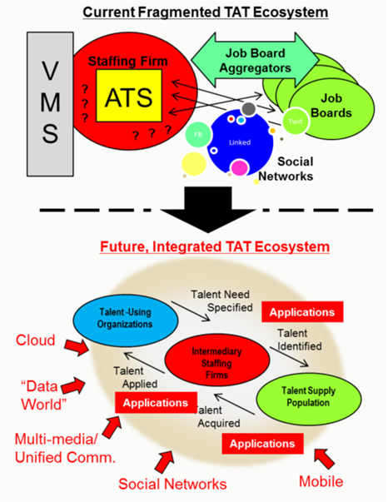
Global Professional Services Industry: IT Trends Hot IT Implementation Trends in HR & Employment Services
Online/video interviews may now be the most “visible” and hottest area in Talent Acquisition Technology (TAT) environnent
It may also be a broader, new-entrant e-Platform that joins “major platform businesses” like LinkedIn and oDesk, that have the potential to absorb and reengineer large segments of staffing industry “value-added processing.”
Many staffing firms have already started down this path –perhaps without realizing it—by deploying VOIP/integrated telephony, maybe integrating it with some other systems. But probably most have not really thought explicitly about the problem from a UC perspective
Many communications vendors and even software vendors, such as Microsoft, have been pushing to make UC available to smaller and midsized firms
2012- Leading on-demand digital interviewing platform provider, HireVue secures $22 Million to modernize and reinvent the recruiting process
Notes:
Sources:
http://www.staffingtalk.com/staffing-industry-trends-2012-expert-predictions/
http://www.staffingindustry.com/Research-Publications/Blogs/Andrew-Karpie-s-Blog/Staffing-Firms-and-Technology-in-2012-Challenging-Staffing-Firms-At-Their-Own-Game

Slide 49


Global Professional Services Industry: IT Trends
Hot IT Implementation Trends in Real Estate Advisory Services Firms
Commercial Real Estate: Bringing information technology onto the construction site
Traditionally, building design and construction has relied solely on two-dimensional printed drawings to represent the work that needs to be completed by field personnel.
Within the last few years, however, contractors have implemented technology that enables project teams to obtain information electronically
This shift from printed to electronic planning allows companies to identify and resolve issues more quickly, allowing for more time to innovate and focus on broader project deliverables
Real estate companies deploy iPads and the cloud
2012- Brisbane-based real estate agency, First Commercial Realty, is the latest commercial real estate firm to equip its entire sales force with iPads and the Surga Central cloud-based CRM software application from Adept Business Systems.
In addition to managing contacts and property listingsreal estate agents could capture requirements to lease or purchase real estate, add notes and generate property marketing brochures - without the need to involve administrators
- 49 -
Notes:
Source:
http://www.bizjournals.com/seattle/print-edition/2012/06/29/commercial-real-estate-bringing.html?page=all
http://www.itwire.com/cloud-computing/55878-real-estate-companies-deploy-ipads-and-the-cloud-with-surga-central

Slide 50
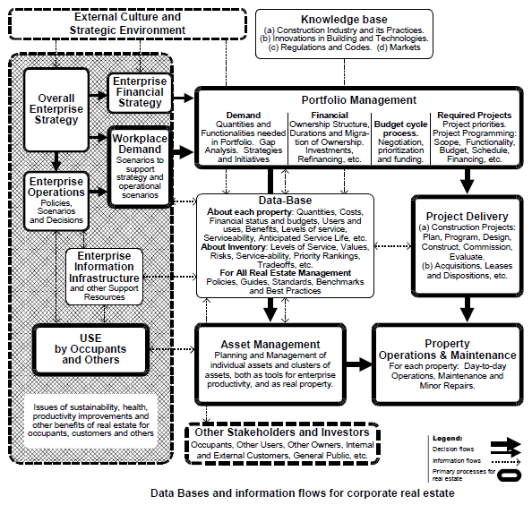
Global Professional Services Industry: IT Trends
Information Flow Management in Real Estate Advisory Services Firms
Real Estate Industry Information Management
At the top left, the box for External Environment represents the external competitive market environment, with business cycles and legislative changes, fast changing information technologies, and emerging global pressures.
At the bottom, the box for Other Stakeholders and
Investors reflects the roles of shareholders, customers, and the general public interests.
Portfolio Management assembles the roll-up totals and summaries in groupings to compare demand profiles of occupant groups from core business units.
Corporate data about real estate is held across many data silos. There are several software packages that do an excellent job for data users for some parts of day-to-day operations, or for design and construction.
There also are a few that are adequate over a somewhat broader range of other tactical information needs, but none that link portfolio issues to asset issues, project issues, and workplace demand as discussed earlier in this paper.
Figure also adds enterprise-wide functions to the diagram. It shows the overall enterprise strategy as not only the driver of enterprise operations, with their resultant scenarios and decisions, but also as a direct decision driver of the overall real estate strategy.
- 50 -
Notes:
Source:
http://www.icf-cebe.com/readers_corner/value_chain%20_cre_2000-06-25_szigeti_davis.pdf

Slide 51
Table of Content
Global Professional Services MI
Market Overview
Industry Insights
Deals Space
Business Trends
Top 100 Accountancy Firms
Technology Trends
Top 100 Legal Services Companies
Competitive Landscape
Top 5 HR & Employment Services Companies
Market Forecast
Top 50 Management Consulting Companies
Disclaimer:
The information presented in this report is based on data available in the public domain. If you find that it is incorrect, please let us know.

Slide 52
Global Professional Services Industry: Competition
Ranking Methodology
Methodology used for the ranking
Accounting Firms
Legal Firms
Management Consultancy Firms
40% prestige 20% firm culture 10% work/life balance 10% compensation 10% business outlook 10% overall job satisfaction
Vault has taken survey from 16,826 attorneys. And then the firms were ranked as per the most prestigious law firms based on the perceptions of currently practicing lawyers at peer firms
30% prestige
15% satisfaction
15% firm culture
15% compensation
10% work-life balance
10% overall business outlook
5% promotion policies
- 52 -
Notes:
Source:
http://www.vault.com/wps/portal/usa/rankings/methodology?rankingId1=252&rankingId2=252&rankings=1&regionId=0&rankingYear=2012

Slide 53
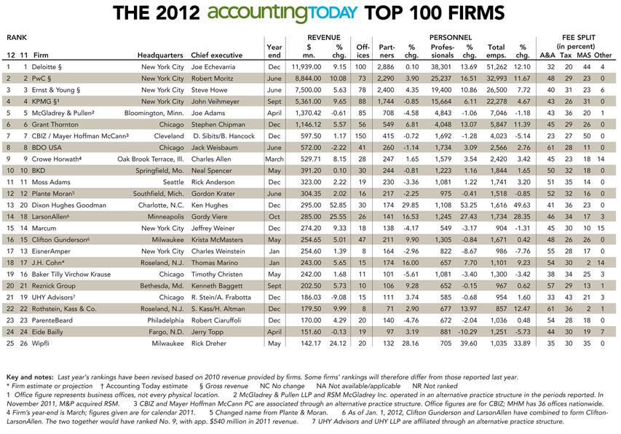
Global Professional Services Industry: Competition Top 100 Accountancy Firms
Notes:
http://digital.accountingtoday.com/accountingtoday/2012top100#pg3

Slide 54
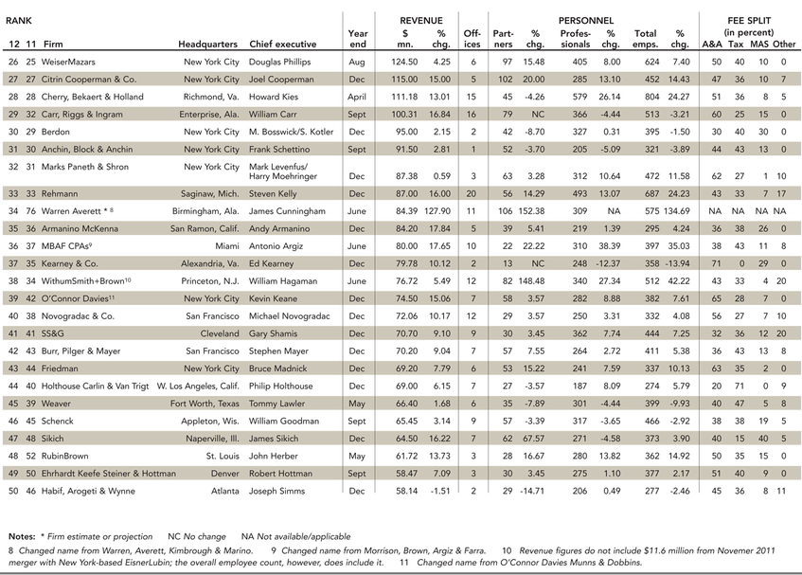
Global Professional Services Industry: Competition Top 100 Accountancy Firms
Notes:
http://digital.accountingtoday.com/accountingtoday/2012top100#pg3

Slide 55
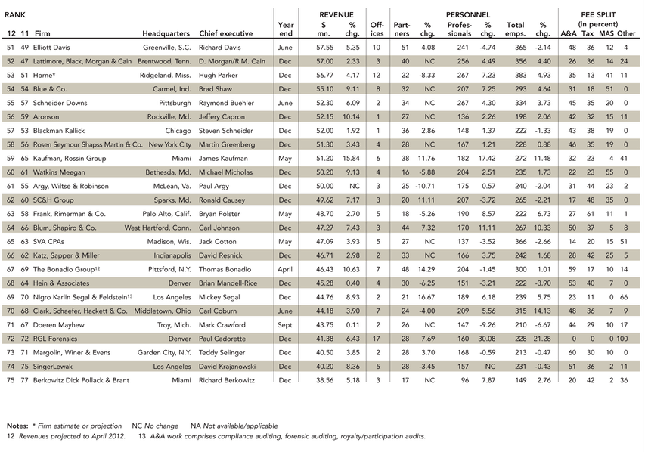
Global Professional Services Industry: Competition Top 100 Accountancy Firms
Notes:
http://digital.accountingtoday.com/accountingtoday/2012top100#pg3

Slide 56
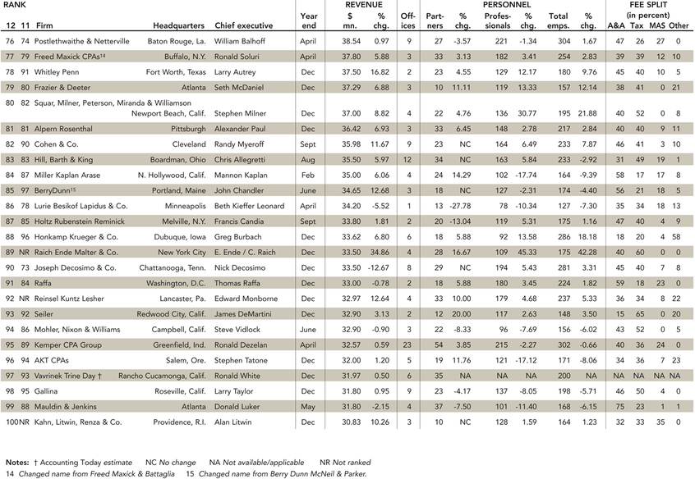
Global Professional Services Industry: Competition Top 100 Accountancy Firms
Notes:
http://digital.accountingtoday.com/accountingtoday/2012top100#pg3

Slide 57
Global Professional Services Industry: Competition
Top 100 Legal Services Companies
Methodology used for the ranking
Legal Firms
Vault has taken survey from 16,826 attorneys. And then the firms were ranked as per the most prestigious law firms based on the perceptions of currently practicing lawyers at peer firms
- 57 -
Notes:
Source:
http://www.vault.com/wps/portal/usa/rankings/methodology?rankingId1=252&rankingId2=252&rankings=1&regionId=0&rankingYear=2012

Slide 58
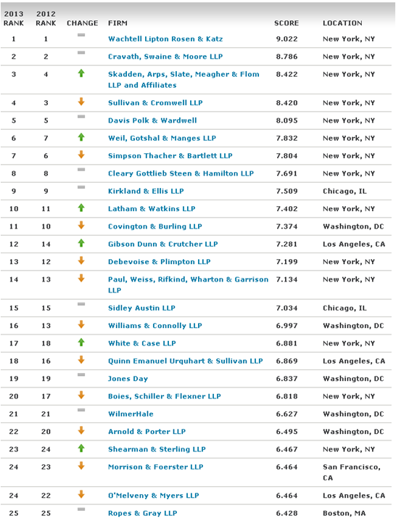
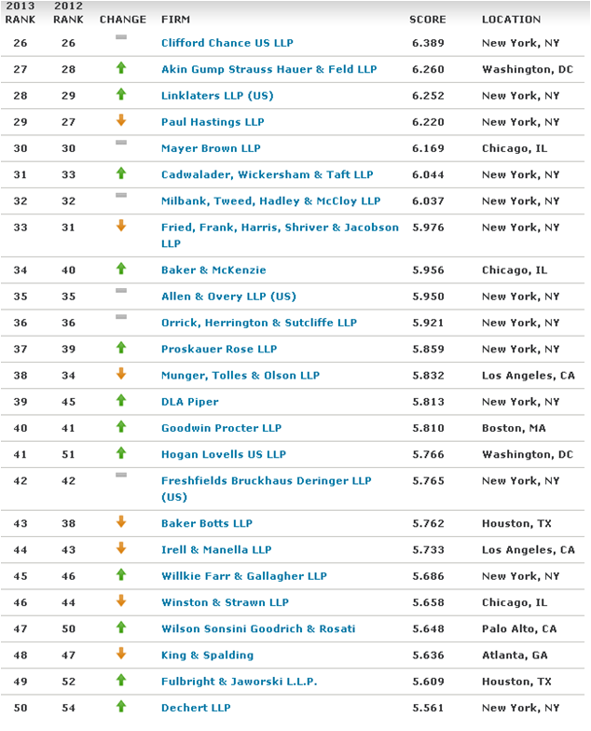
Global Professional Services Industry: Competition
Top 100 Legal Services Companies (1/2)
- 58 -
Notes:
Source:
http://www.vault.com/wps/portal/usa/rankings/individual?rankingId1=2&rankingId2=-1&rankings=1&regionId=0&rankingYear=2013&pageRange=1-25

Slide 59
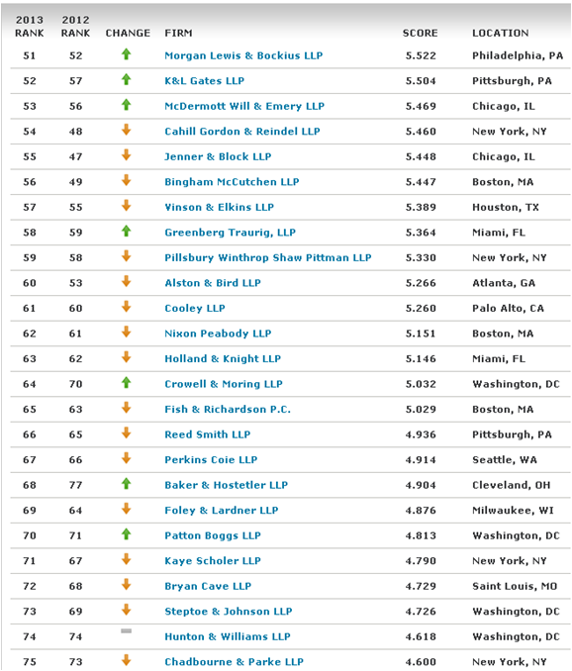
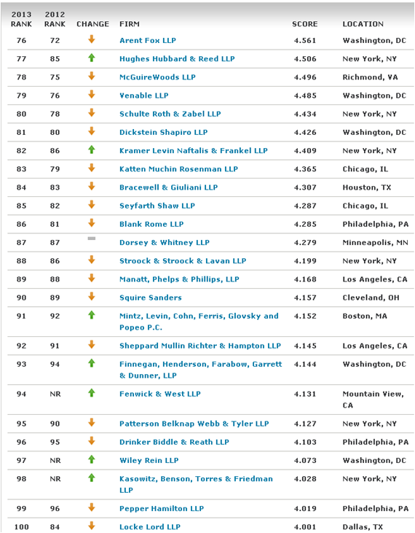
Global Professional Services Industry: Competition
Top 100 Legal Services Companies (2/2)
- 59 -
Notes:
Source:
http://www.vault.com/wps/portal/usa/rankings/individual?rankingId1=2&rankingId2=-1&rankings=1&regionId=0&rankingYear=2013&pageRange=1-25

Slide 60
Global Professional Services Industry: Competition
Top 5 HR & Employment Services Companies
“
5 largest global staffing companies, 2011
Rank | Company | Revenue ($millions) | Market Share
1 | Adecco | 28.1 | 6.92%
2 | Randstad Holding | 22.6 | 5.58%
3 | Manpower Group | 22.0 | 5.43%
4 | Allegis Group | 8.3 | 2.04%
5 | Kelly Services | 5.6 | 1.37%
The larger staffing companies have grown at the expense of smaller companies. The firms on our list had total revenues of $187 billion in 2011 representing almost half of global revenues and achieved an average growth rate of 22%
“
John Nurthen
Staffing Industry Analysts’ executive director
Staffing Industry Analysts estimates the global staffing market to be worth approximately $406 billion with a 9% growth over the prior year.
Over 100 staffing companies had 2011 annual revenues in excess of $300 million and only three firms recorded lower revenues in 2011 as compared to 2010.
- 60 -
Notes:
Sources:
http://www.staffingindustry.com/About/Press-Releases/Staffing-Industry-Analysts-Releases-List-of-Largest-Global-Staffing-Firms

Slide 61
Global Professional Services Industry: Competition
Top 50 Management Consulting Companies
Methodology used for the ranking
Management Consultancy Firms
30% prestige
15% satisfaction
15% firm culture
15% compensation
10% work-life balance
10% overall business outlook
5% promotion policies
- 61 -
Notes:
Source:
http://www.vault.com/wps/portal/usa/rankings/methodology?rankingId1=252&rankingId2=252&rankings=1&regionId=0&rankingYear=2012

Slide 62
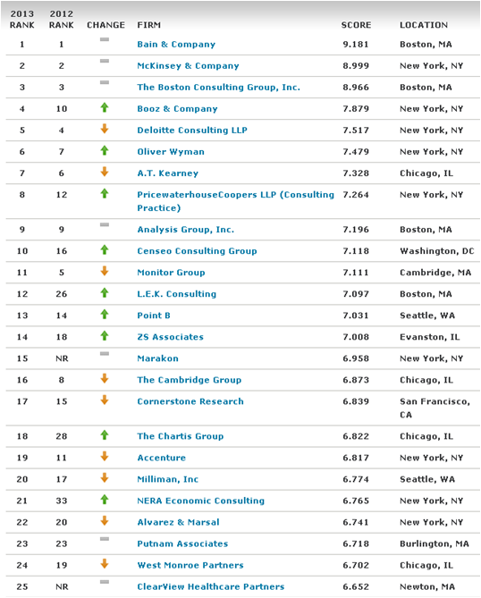
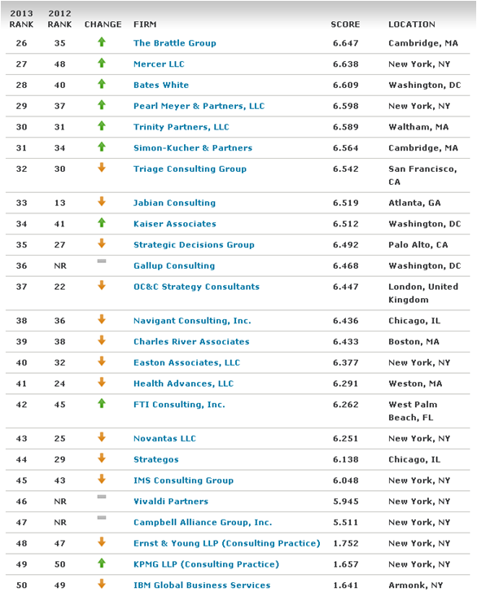
Global Professional Services Industry: Competition
Top 50 Management Consulting Companies
- 62 -
Notes:
Sources:
http://www.vault.com/wps/portal/usa/rankings/individual?rankingId1=248&rankingId2=-1&rankings=1&regionId=0&rankingYear=2013&pageRange=26-50

Slide 63
Table of Content
Global Professional Services MI
Market Overview
Industry Insights
Deals Space
Business Trends
Accountancy Services Market Forecast
Technology Trends
HR & Employment Services Market Forecast
Competitive Landscape
Legal Services Market Forecast
Management & Marketing Consultancy Market Forecast
Market Forecast
Real Estate Market Forecast
Disclaimer:
The information presented in this report is based on data available in the public domain. If you find that it is incorrect, please let us know.

Slide 64
Global Professional Services Industry: Market Forecast Accountancy Market Forecast
Global accountancy industry value forecast: $ billion, 2010–15
Year | $ billion | % Growth
2010 | 364.3 | 3.4%
2011 | 389.6 | 7.0%
2012 | 412.3 | 5.8%
2013 | 435.8 | 5.7%
2014 | 460.7 | 5.7%
2015 | 487.6 | 5.8%
CAGR: 2010–15 |  | 6.0%
$ billion (e)
% growth
Year
In 2015, the global accountancy market is forecast to have a value of $487.6 billion, an increase of 33.9% since 2010
The CAGR of the market in the period 2010–15 is predicted to be 6%
Notes:
Datamonitor Industry Profile - Global Accountancy (September 2011)

Slide 65
Global Professional Services Industry: Market Forecast HR & Employment Services
Global human resource & employment services market value forecast: $ million, 2011–16
Year | $ billion | % Growth
2011 | 377.1357 | 5.8%
2012 | 397.4938 | 5.4%
2013 | 419.1602 | 5.5%
2014 | 442.414 | 5.5%
2015 | 465.707 | 5.3%
2016 | 490.0947 | 5.2%
CAGR: 2011–16 |  | 5.4%
$ billion (e)
% growth
Year
In 2016, the global human resource & employment services market is forecast to have a value of $490,094.7 million, an increase of 30% since 2011
The CAGR of the market in the period 2011–16 is predicted to be 5.4%
Notes:
Datamonitor Industry Profile - Global Accountancy (September 2011)

Slide 66
Global Professional Services Industry: Market Forecast Legal Services
Global legal services market value forecast: $ million, 2010–15
Year | $ billion | % Growth
2010 | 176.2 | -0.20%
2011 | 183.8 | 7.80%
2012 | 194 | 4.50%
2013 | 204.3 | 4.30%
2014 | 215.2 | 4.60%
2015 | 225.1 | 4.50%
CAGR: 2010–15 |  | 5.1%
$ billion (e)
% growth
Year
In 2015, the global legal services market is forecast to have a value of $751.76 billion, an increase of 28.4% since 2010.
The industry is expected to see highest growth in the year of 2012
Notes:
Datamonitor Industry Profile - Global Accountancy (September 2011)

Slide 67
Global Professional Services Industry: Market Forecast Management & Marketing Consultancy Market
Global Management & Marketing Consultancy market value forecast: $ million, 2011–16
Year | $ billion | % Growth
2011 | 301.1 | 6.2%
2012 | 316.1 | 5.0%
2013 | 333.3 | 5.4%
2014 | 353.5 | 6.1%
2015 | 376.4 | 6.5%
2016 | 402.3 | 6.9%
CAGR: 2011–16 |  | 6.0%
$ billion (e)
% growth
Year
In 2016, the global management & marketing consultancy market is forecast to have a value of $402.3 billion, an increase of 33.6% since 2011.
The CAGR of the market in the period 2011–16 is predicted to be 6.0%
Notes:
MarketLine Industry Profile - Global Management & Marketing Consultancy (Aug 2012)

Slide 68
Global Professional Services Industry: Market Forecast Real Estate Management & Development Market
Global real estate management and development market value forecast: $ million, 2011–16
Year | $ billion | % Growth
2011 | 377.1357 | 5.8%
2012 | 397.4938 | 5.4%
2013 | 419.1602 | 5.5%
2014 | 442.414 | 5.5%
2015 | 465.707 | 5.3%
2016 | 490.0947 | 5.2%
CAGR: 2011–16 |  | 5.4%
$ billion (e)
% growth
Year
In 2016, the global real estate management & development industry is forecast to have a value of $477 billion, a decrease of 0.5% since 2011
The CAGR of the market in the period 2011–16 is predicted to be -0.1%
Notes:
MarketLine Industry Profile - Global Real Estate Management & Development (Aug 2012)

Slide 69
Thank you for reading the report. Was the report useful to you? Do you need more research?
Please send your comments / suggestions to:
swati.malaker@tcs.com
aditi.royghatak@tcs.com

